Slide 1
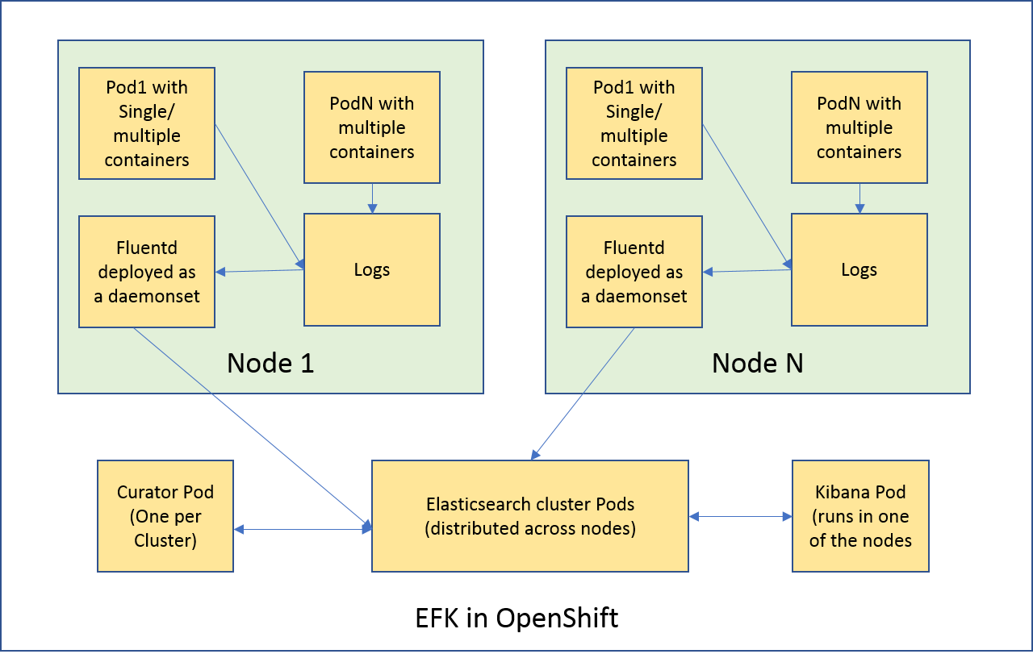
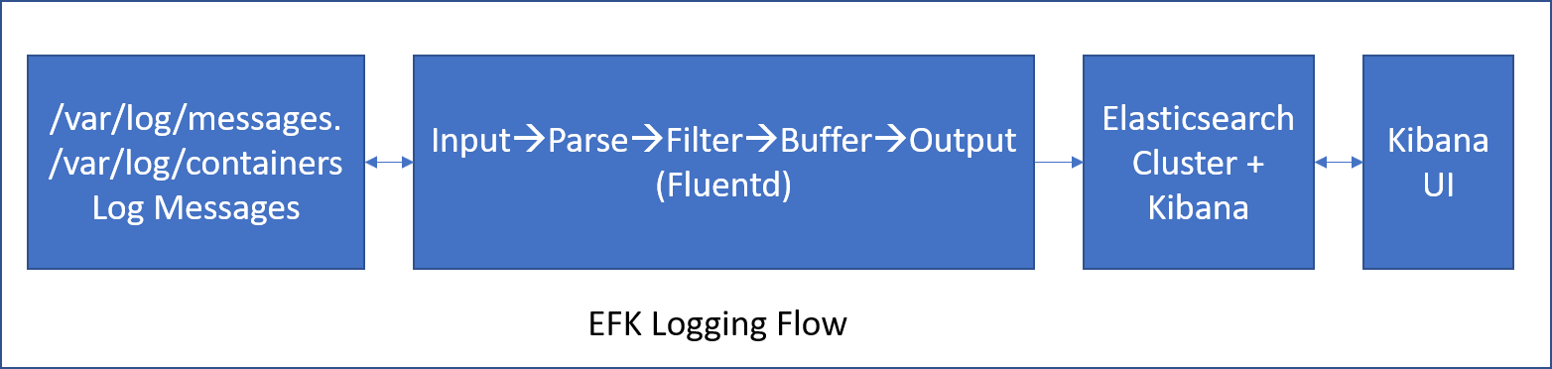
Knowledge Nugget of the Day – EFK on Openshift
Modernization >> Emerging Technology Paradigms
The EFK stack is a modified version of the ELK stack and is comprised of Elasticsearch (An object store to store logs), Fluentd(To gather logs from nodes and feed them to Elasticsearch), Kibana (A web UI for Elasticsearch).
Logging architecture using EFK in OpenShift
The diagrams depicts the logging architecture and flow using EFK in OpenShift
For ingesting logs, Flutend will be deployed as a deamonset on individual nodes where the logs are being generated. But Elastic and Kibana will be deployed together in a single container. This is achieved through Ansible playbook configuration. Detailed guidelines of setting up EKF is available as a part of OpenShift documentation
After deploying the above in a cluster, the stack aggregates logs from all nodes and projects into Elasticsearch, and provides a Kibana UI to view any logs. Cluster administrators will be able to view all logs, but application developers can only view logs for projects they have permission to view.
January, 2019 | Curator: Murugavel Ramamurthy (164016)
References : https://docs.openshift.com/enterprise/3.1/install_config/aggregate_logging.html#deploying-the-efk-stack

Slide 2
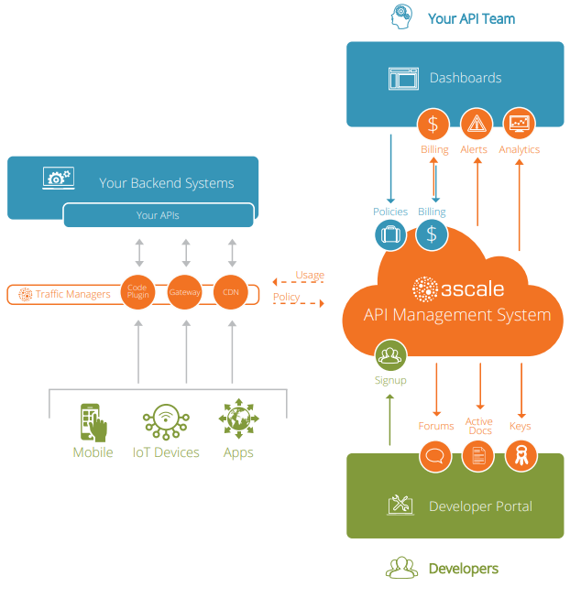
Knowledge Nugget of the Day – 3Scale API gateway
Modernization >> Software Defined and Managed Infrastructure
3scale is the API management platform which has built-in features to help build a more successful API program, including access control, rate limits, payment gateway integration, and developer experience tools. 3scale makes it easy to open, control, distribute and monetize APIs.
Features :
API traffic control : Helps in protecting backend API servers with strict traffic control on incoming and outgoing traffic. Multiple options available for traffic control – from open source gateways to a hosted cloud service, plugins, and CDN options.
Deployment overview : Multiple gateway deployment options like APICAST self-managed, Amazon API Gateway are available
Access Control & Security : Secures the API with Authentication patterns like Oauth. Also has access control features to restrict access to specific endpoints.
Rate Limits : Has application plans that allows to set rate limits for API usage and control traffic flow for groups of developers
Developer portal
Active Docs : By adding a Swagger-compliant specification to API, the interactive documentation is immediately available for developers.
Analytics : 3scale allows us to define the metrics and methods for each endpoint that needs tracking
Monetization : Helps define and set up pricing rules for application plans
Dashboard : Provides insight into API services, traffic, developer engagement
January, 2019 | Curator: Murugavel Ramamurthy (164016)
References : https://www.3scale.net/

Slide 3
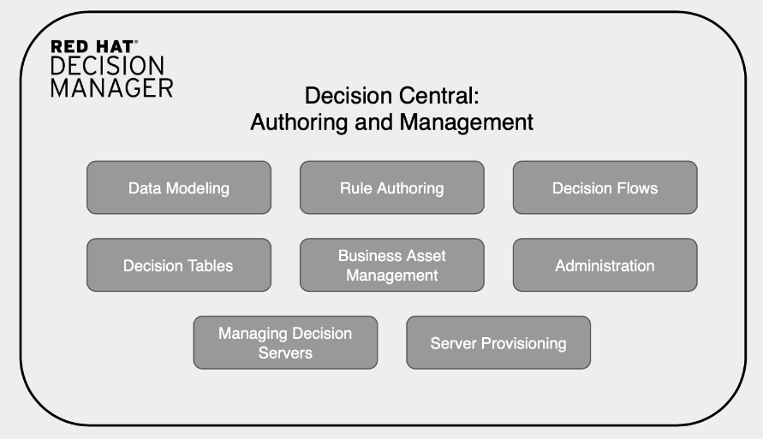
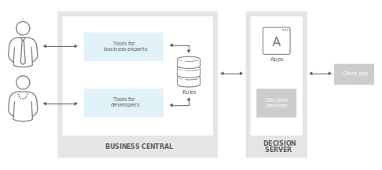
Knowledge Nugget of the Day – RedHat DecisionManager
Modernization >> Webscale IT Architecture
Red Hat Decision Manager is a powerful, scalable, open source business rule management solution. It provides strong support for enterprise users in formulating and implementing business logic and developing applications based on the use of automated business decisions. Red Hat Decision Manager fully collaborates with Red Hat OpenShift Container Platform to ensure that its applications can work seamlessly in any infrastructure environment, hybrid-cloud implementation.
Features :
Automate decision making : Has a highly scalable rules engine derived from the Drools that helps in evaluating business rules to draw conclusions from live data. CEP (Complex event processing) extensions from the Drools Fusion project add the ability to process time-based constraints providing real-time decision making.
Optimize resources : Has inbuilt toolkit designed to help Java developers construct applications that solve complex scheduling and resource optimization problems. It uses the BRMS rules engine to quickly find solutions to problems that are otherwise extremely difficult, time-consuming, and expensive to solve
Empower business analysts and IT : supports a business-friendly UI for quick definition and simplified changes of sophisticated business knowledge for business applications governance. Usage of simple metaphors such as decision tables, scorecards, and domain-specific languages helps IT and business users quickly create and change business rules.
Optimized for cloud and containers : Provides support for on-premise; virtual; or in private, public, and hybrid clouds.
January, 2019 | Curator: Murugavel Ramamurthy (164016)
References : https://www.redhat.com/en/technologies/jboss-middleware/business-rules/

